Slide 1


Unit 2: Lesson 6 A field trip

Slide 2
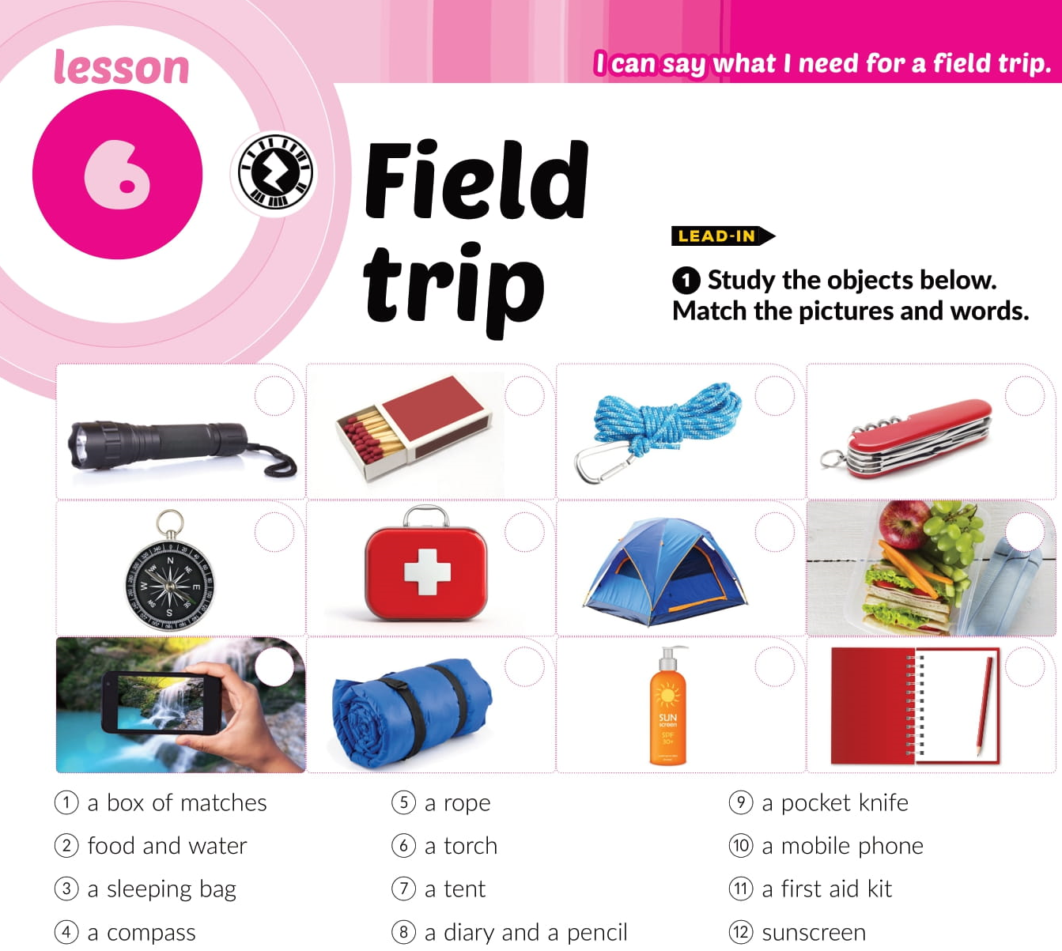
6
1
5
9
4
11
7
2
10
3
12
8

Slide 3
sunscreen
a torch
a knife
matches
a diary
a mobile phone
a first aid kit
a sleeping bag
food and water
a rope
a tent

Slide 5

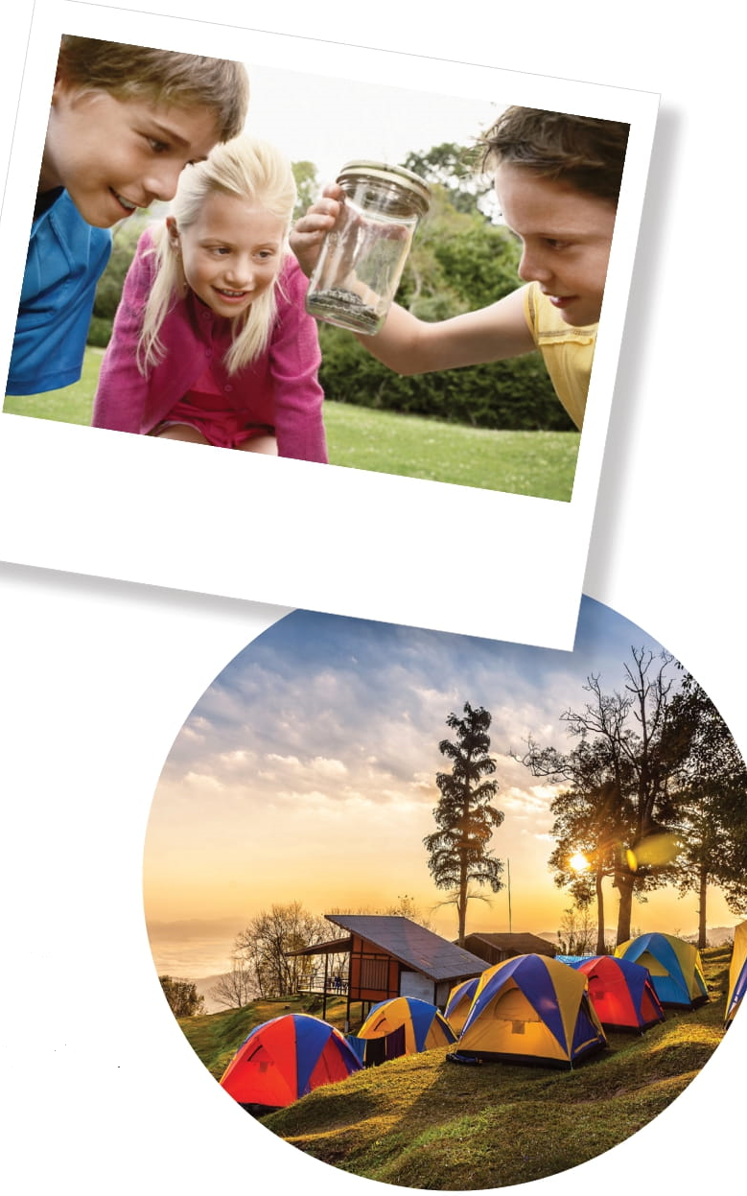
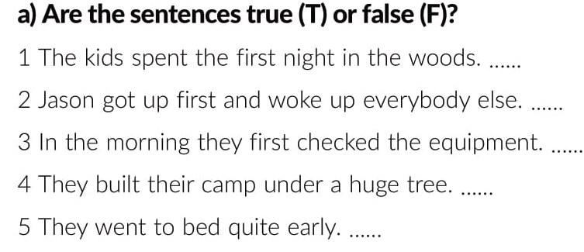
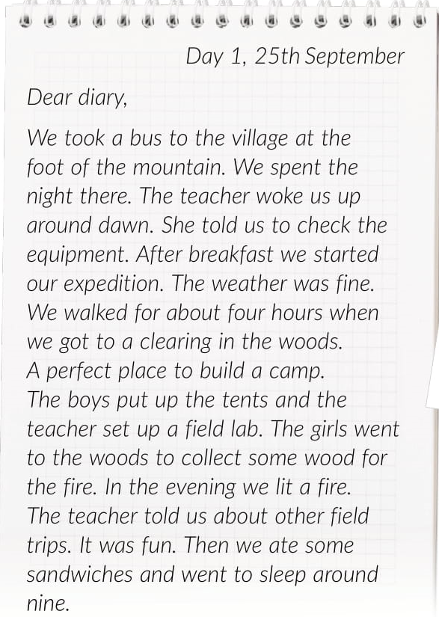
F
F
T
F
T
https://www.e-sfera.hr/dodatni-digitalni-sadrzaji/75ad5470-956c-4c9b-903b-80af37579d44/

Slide 6

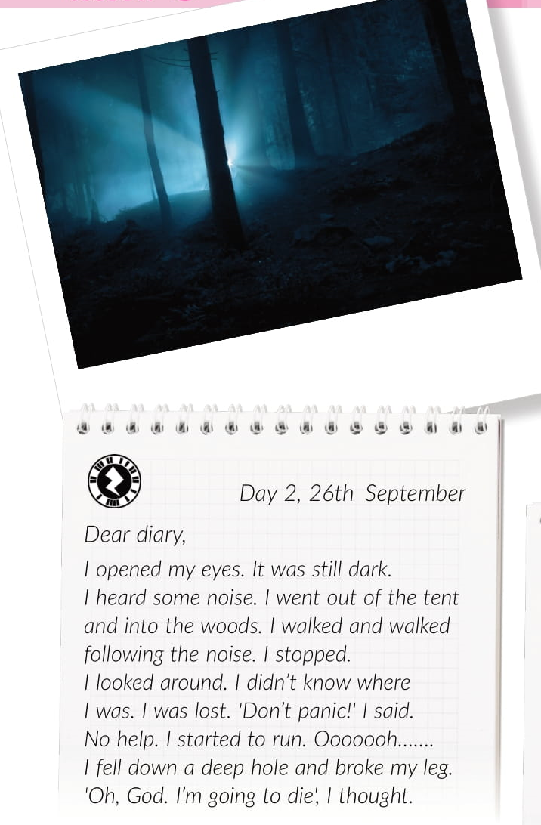
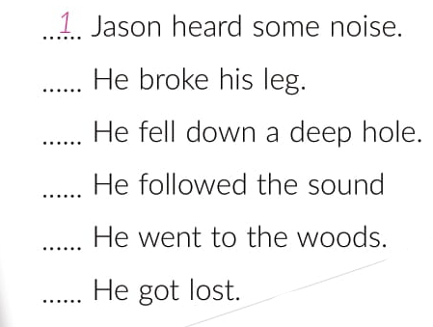
6
5
3
2
4

Slide 7
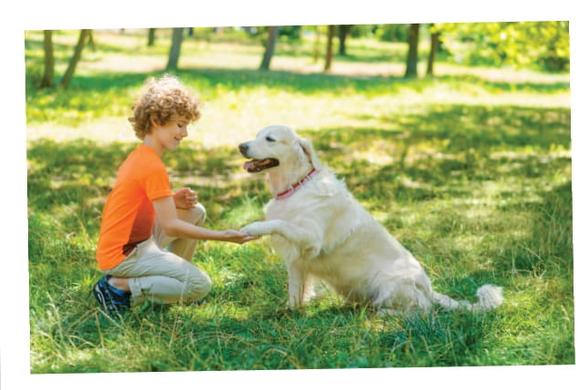
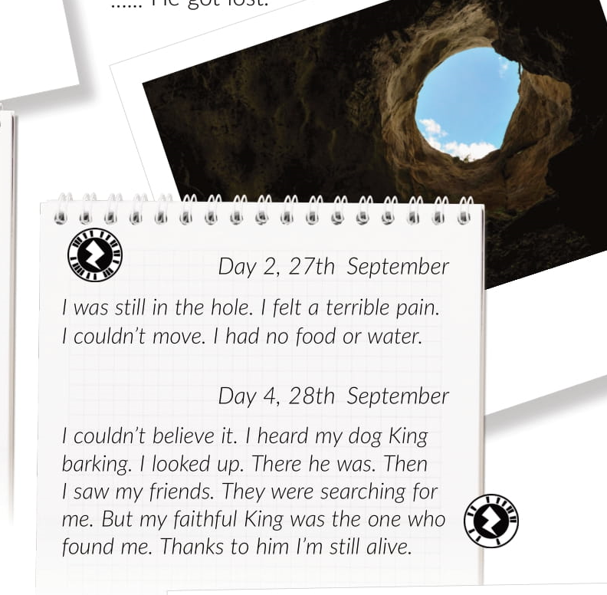
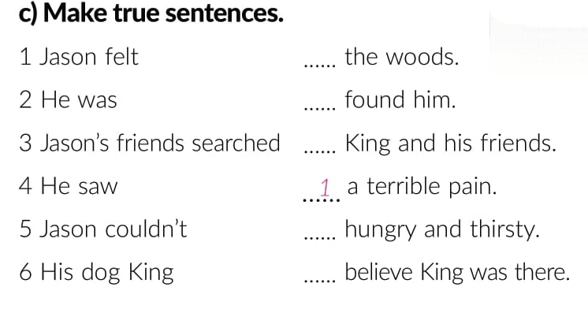
3
6
4
2
6

Slide 8
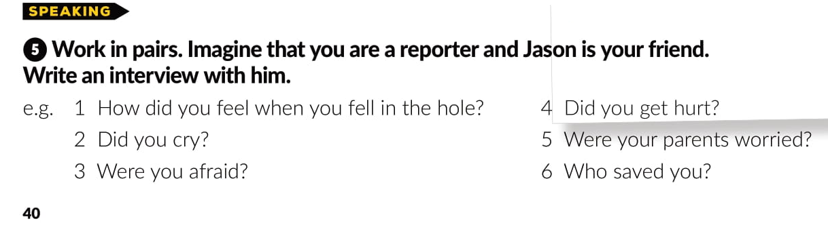

Slide 10
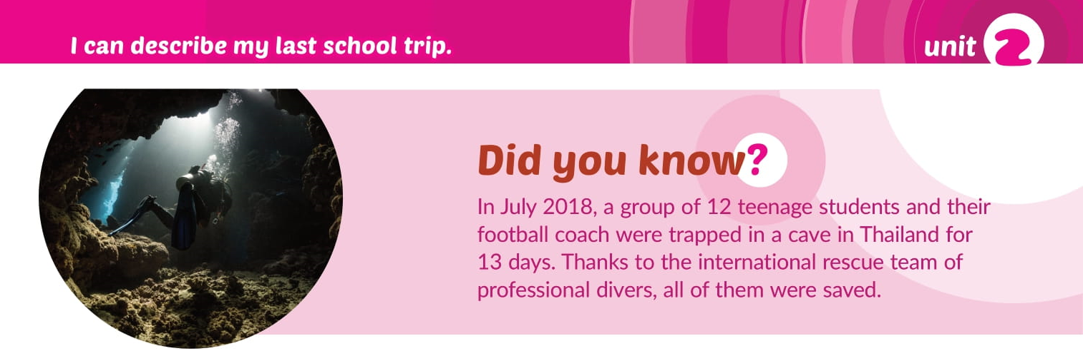

Slide 11
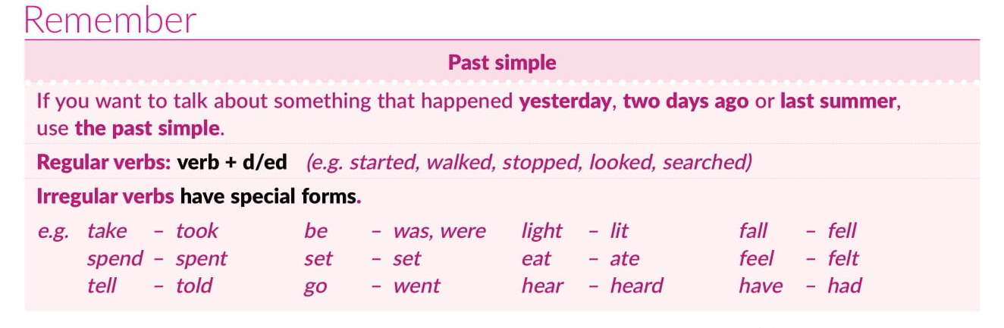
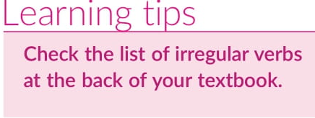
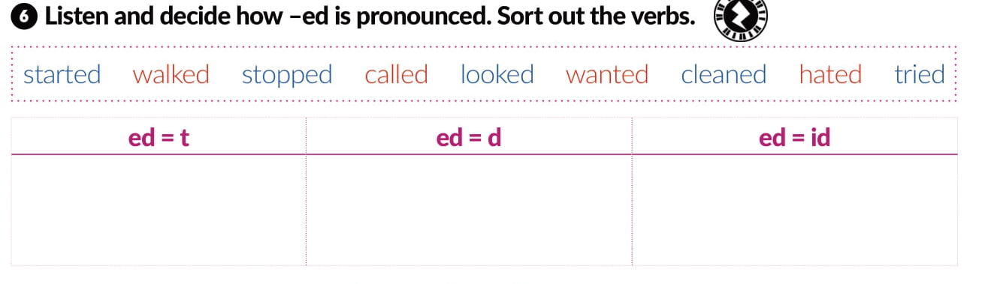
walked
called
started
stopped
cleaned
wanted
tried
hated
loooked

Slide 12
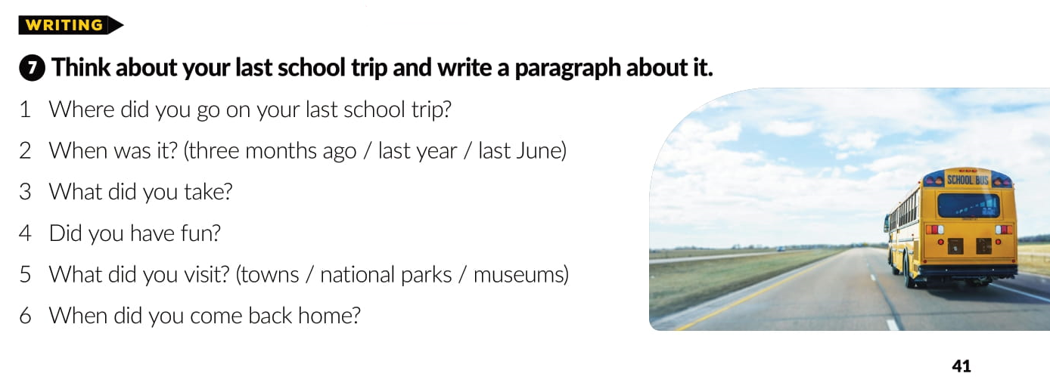

Slide 13
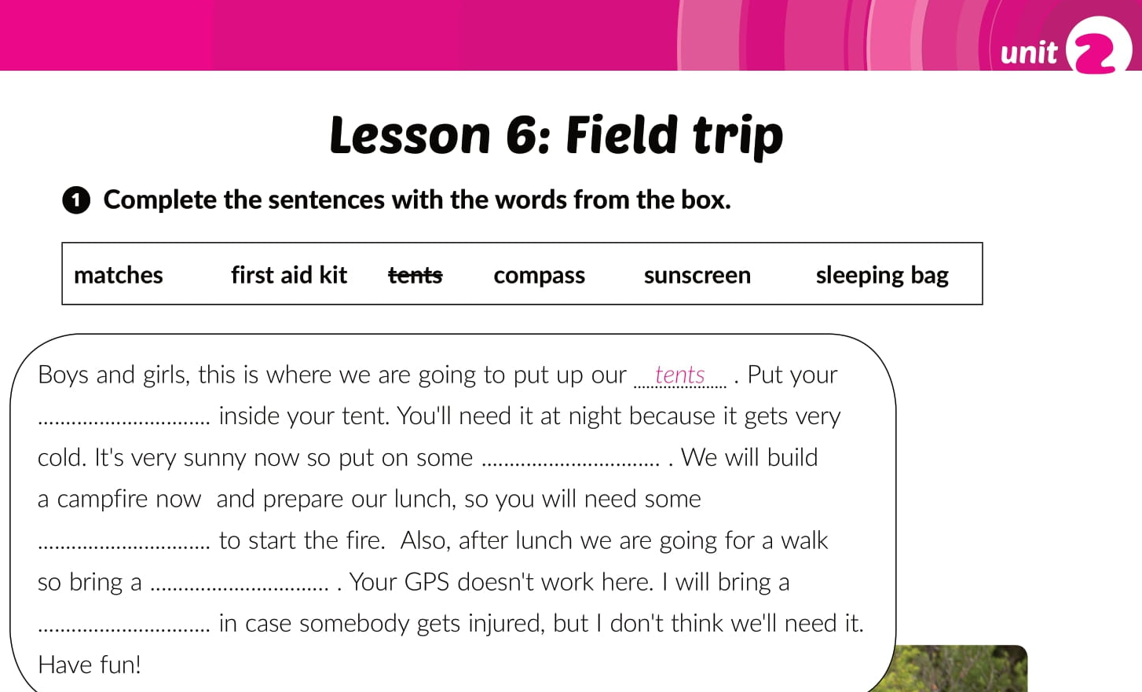
Workbook p. 27
sleeping bag
sunscreen
matches
compass
first aid kit

Slide 14
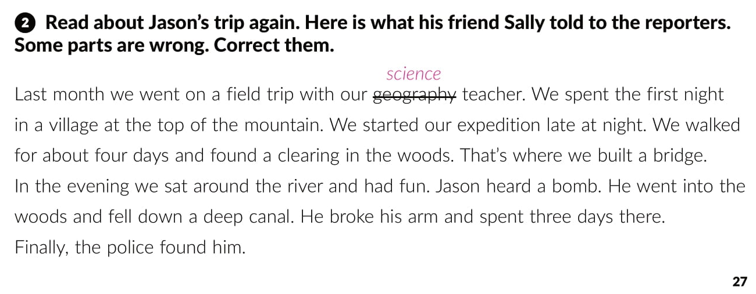
foot
early in the morning
hours
camp
fire
some noise
hole
leg
dog

Slide 15
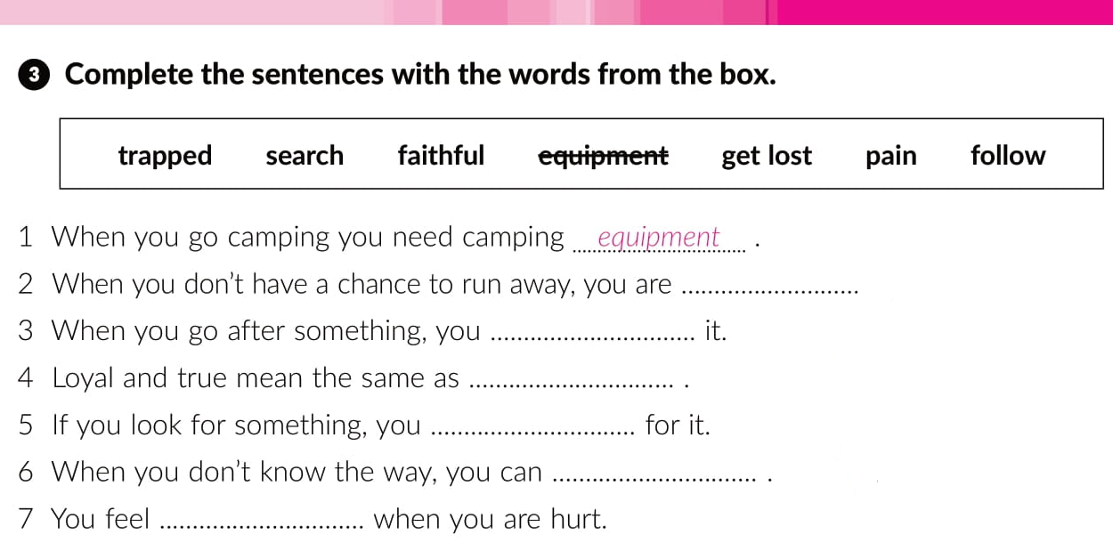
trapped
follow
faithful
search
get lost
pain

Slide 16
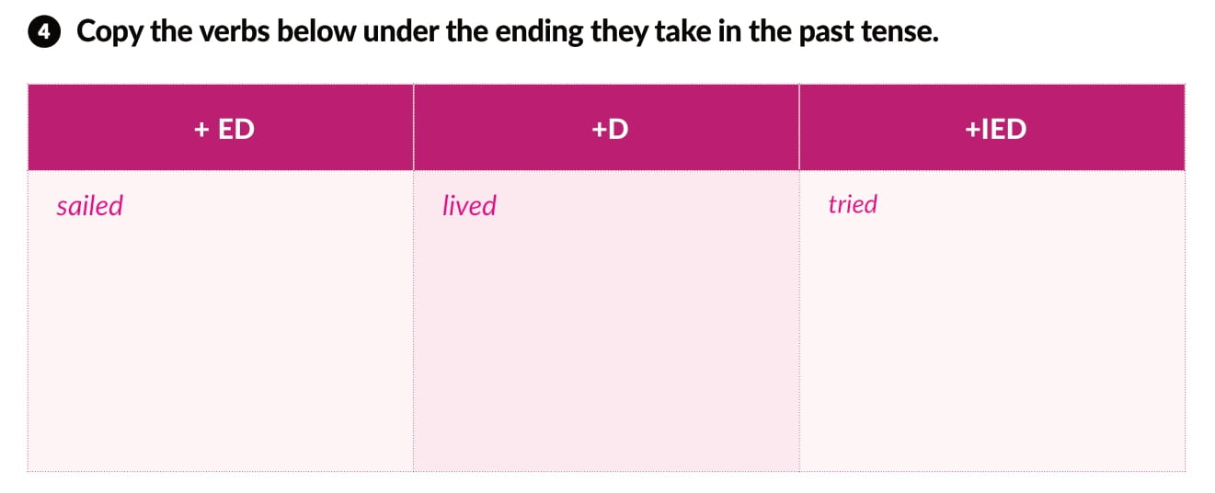
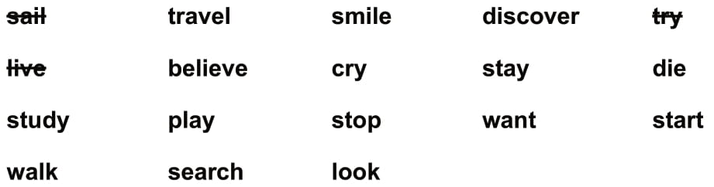
travelled
smiled
cried
discovered
believed
studied
stayed
died
played
stopped
wanted
started
walked
searched
looked

Slide 17
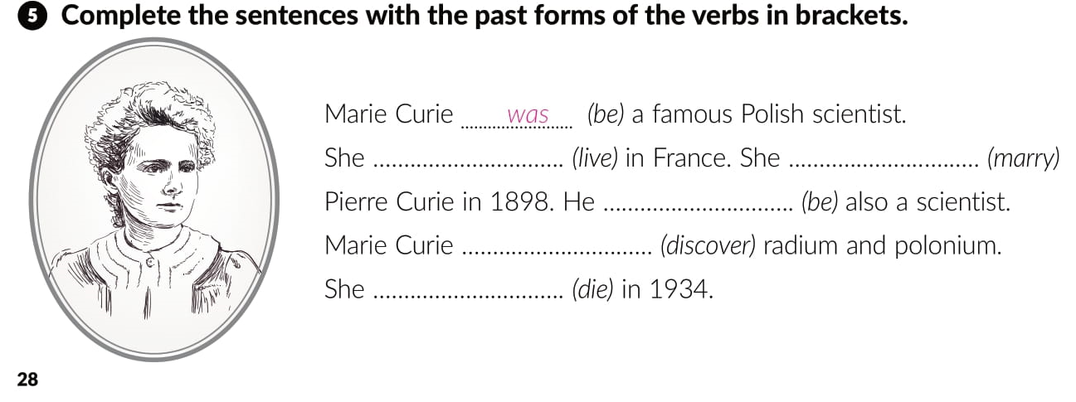
lived
married
was
discovered
died

Slide 18
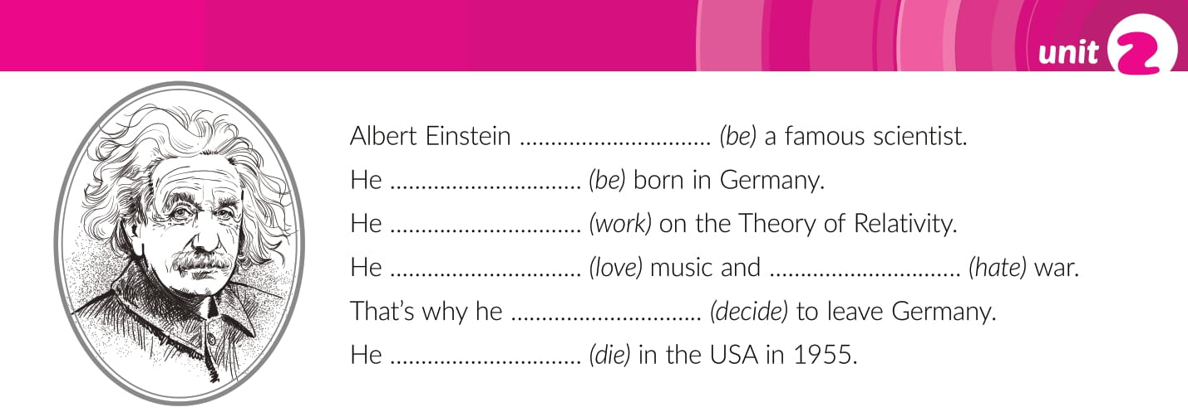
was
was
worked
loved
hated
decided
died

Slide 19
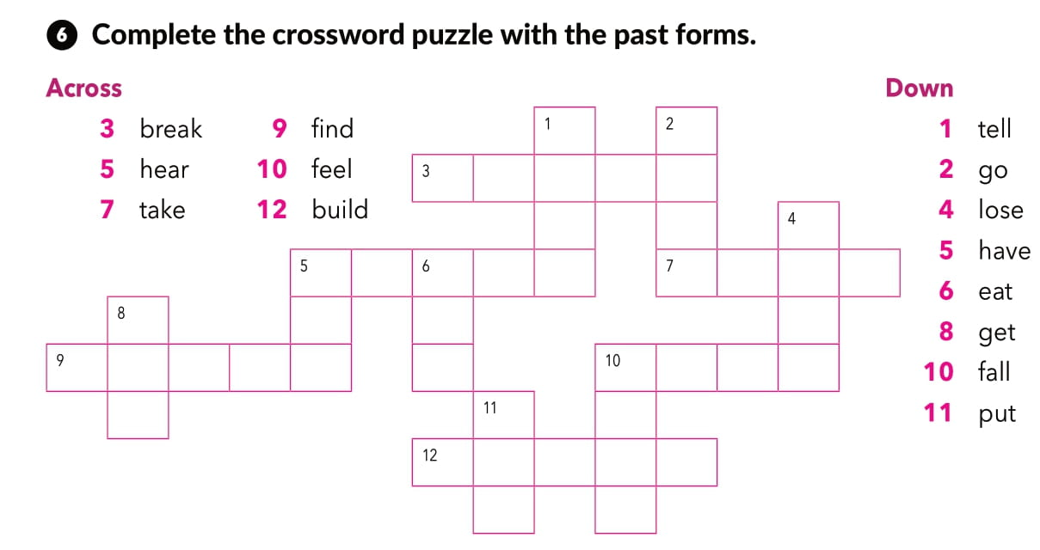
T
O
L
D
w
E
N
T
B R K
L
O
S
T
A
T
E
H
A
D
E R
G
O
T
F U N
F
E
L
L
E L
P
U
T
B I T

Slide 20
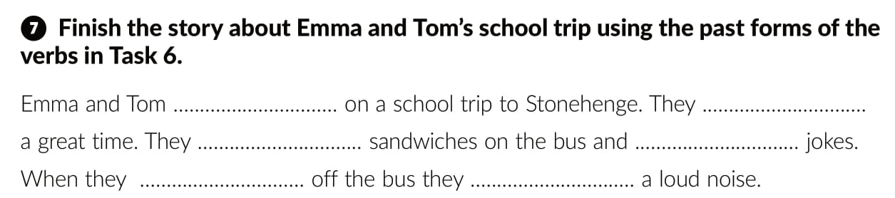
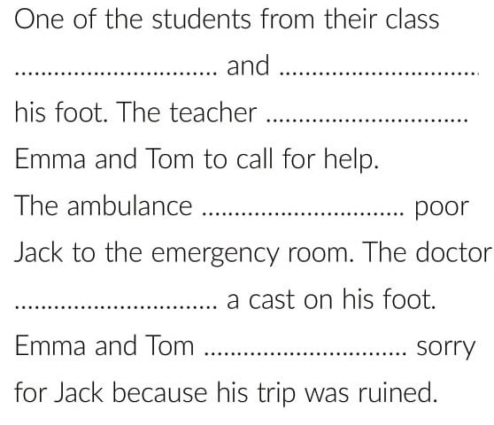
went
had
ate
told
got
heard
fell
broke
told
took
put
felt

Slide 21

PLAY AND LEARN!
https://www.e-sfera.hr/dodatni-digitalni-sadrzaji/75ad5470-956c-4c9b-903b-80af37579d44/

